Slide 1
Python Coding Standards

Slide 2
Naming convention
Functions, variables, and attributes should be in lowercase_ underscore format.
Protected instance attributes should be in _leading_underscore format.
Private instance attributes should be in __double_leading_ underscore format.
Classes (including exceptions) should be in CapitalizedWord format.

Slide 3
Naming convention
Module-level constants should be in ALL_CAPS format.
Instance methods in classes should use self, which refers to the object, as the name of the first parameter.
Class methods should use cls, which refers to the class, as the name of the first parameter

Slide 4
Python coding standards
Instead of using C-style format specifiers like %d, you can specify placeholders with {}/f ’string
Move complex expressions into helper functions, especially if you need to use the same logic repeatedly
An if/else expression provides a more readable alternative to using the Boolean operators or and in expressions

Slide 5
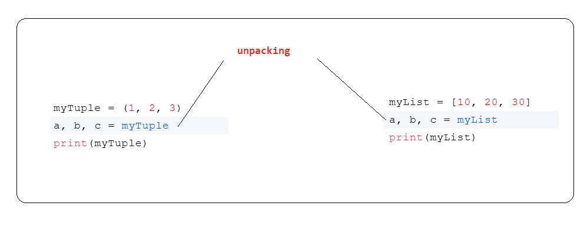
Prefer unpacking over indexing
Python has special syntax called unpacking for assigning multiple values in a single statement
Unpacking is generalized in Python and can be applied to any iterable, including many levels of iterables within iterables.
Reduce visual noise and increase code clarity by using unpacking to avoid explicitly indexing into sequences

Slide 6
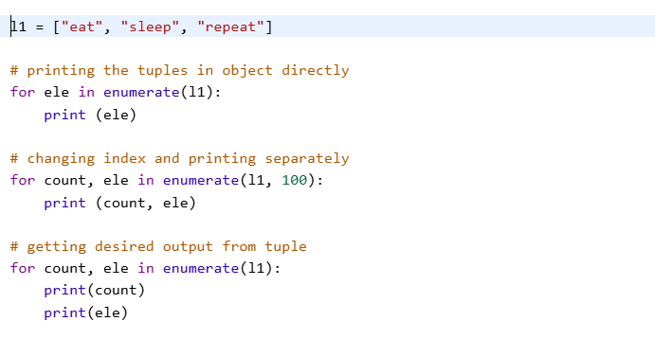
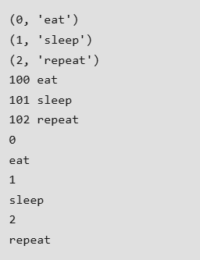
Use enumerate over range in loops
Prefer enumerate instead of looping over a range and indexing into a sequence

Slide 7
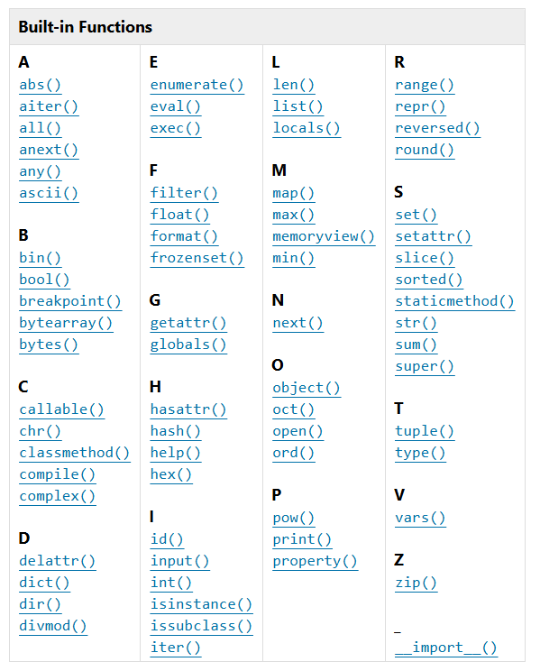
Use Build in Function/API over user defined

